Slide 1
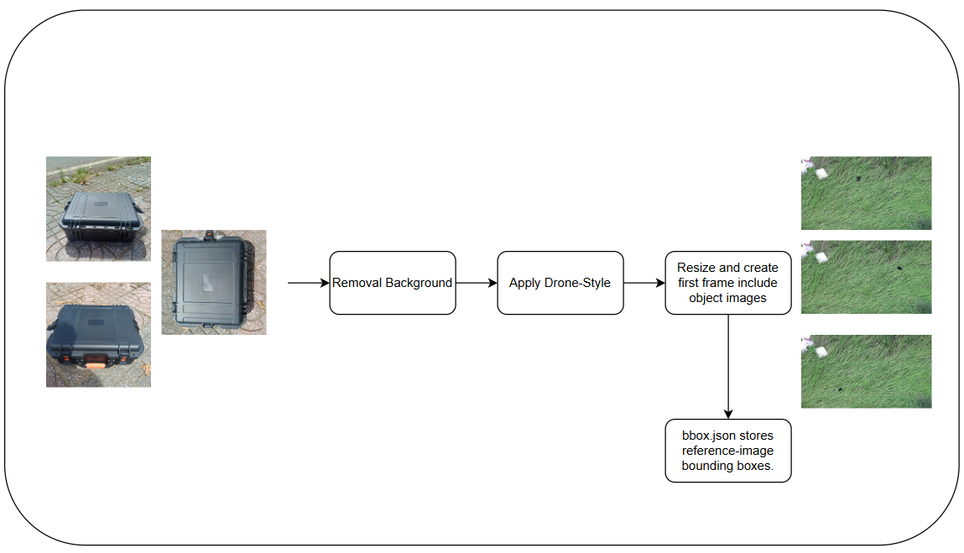
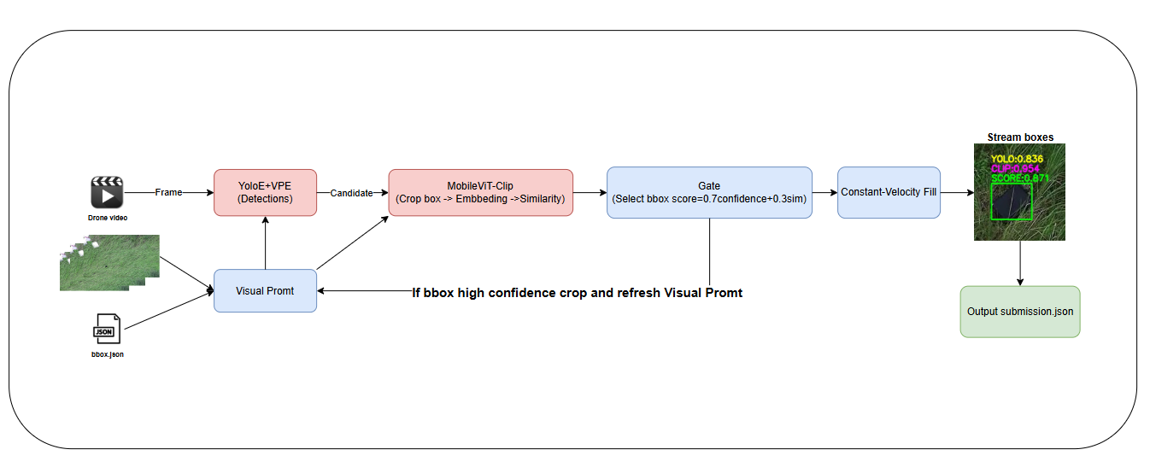
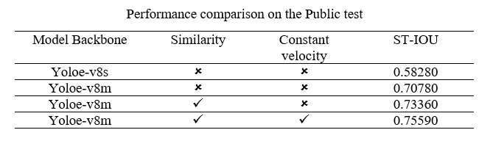
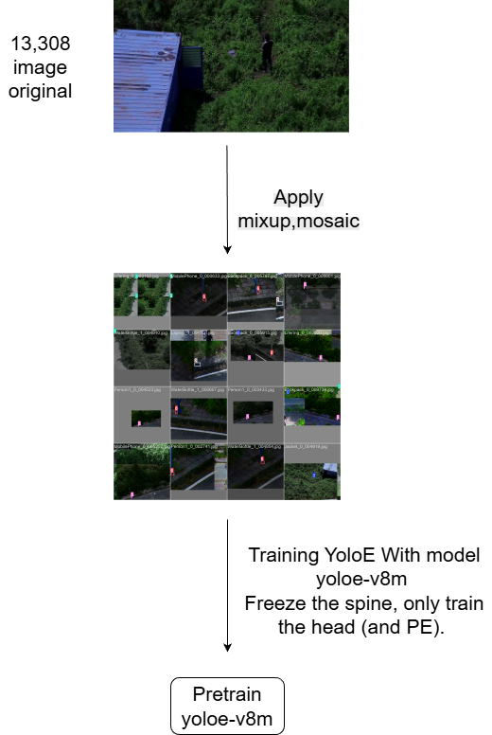
Team IUH_AIers_K16: AeroEyes - Finding and Rescuing With AI-Powered Drones
Nguyễn Chí Nguyện, Võ Hoàng Minh Trí, Cao Lê Minh Khoa, Trần Thanh Dương
INPUT / OUTPUT
Task 2
Input: The system takes three reference images of the same target object captured from different viewpoints (e.g., front/side/angled views) to define the object’s appearance, along with a drone-recorded video sequence in which the object appears.
Output: For each processed video, the system outputs the predicted location of the target object as bounding boxes over time. Detections are stored frame-by-frame (e.g., [..., x1, y1, x2, y2, ...]) and exported in the required submission.json format.
VPE refresh( Re-prompting)
Goal: Provide YOLOE with a high-quality, precise visual prompt that best represents the target object, so the VPE encodes the correct identity and suppresses background/noise matches.
Description: Re-prompting runs only after a detection passes the gating policy. The accepted crop is added to a small, bounded prompt pool that keeps only high-quality samples. On refresh, the pool is used to rebuild the visual prompt embedding and immediately update YOLOE for subsequent frames. Low-quality candidates are rejected to prevent drift, and re-prompting can be frozen once the prompt pool is consistently strong.
SYSTEM ARCHITECTURE / PIPLELINE
Constant-Velocity Fill Method
Data preprocessing
Goal: Maintain a stable bounding box during short detection dropouts to reduce flicker and prevent track loss.
Description: When a frame is missed, estimate velocity from the last two valid bboxes and extrapolate the bbox center forward (with a gain). Progressively shrink bbox size using a linear schedule with a minimum scale floor. If the bbox is near an image border, switch to exit-aware mode by anchoring to the touched side and shrinking primarily along the exit direction (horizontal/vertical/corner). Clamp the bbox to image bounds, ensure non-degenerate width/height, and stop filling when max-miss is reached, the predicted center leaves a safety margin, or the area drops below a ratio threshold (fade-out).
INFERENCE PIPELINE
EXPERIMENTS
TRAINING YOLO PIPELINE
CONCLUSIONS
The detector achieves strong performance on the public test set, demonstrating that a general model can be adapted to new object categories in a few-shot setting using only three reference images per object. This validates the feasibility of prompt-/embedding-based adaptation for rapid deployment when annotated data is limited.
Despite these gains, the model remains sensitive to small targets and visually ambiguous objects, often producing false positives under cluttered backgrounds, low contrast, blur, or noisy/compressed frames. These failure modes indicate that robustness is currently bounded by scale variation and input quality, so the upstream image pipeline is as critical as the detector itself.
Future work should prioritize an end-to-end system that improves (i) object-centric input preprocessing (stabilization, denoising, photometric normalization, and super-resolution for small objects), (ii) multi-scale/context modeling to reduce small-object noise, and (iii) scaling both model capacity and data (larger backbone/head, stronger PE fine-tuning, hard-negative mining, and realistic synthetic augmentation). In addition, systematic false-positive analysis and confidence calibration will be essential to deliver a reliable, deployable few-shot detection pipeline.

